Slide 1
Integrated Breeding Platform (IBP)
Your partner for enhanced breeding
General Overview

Slide 2
About us
Our mission is to accelerate the delivery of new crop varieties in the context of an increasing demand for food, and unprecedented environmental challenges, on the basis of a demand-driven crop variety approach.
We are more than a simple software provider. We are a partner ready to lend expert assistance to have you rise to a new level of breeding innovation.
We have an educational mandate, working in close collaboration with universities, and building internal capacity at partner Institutions, for the sustainable adoption of modern breeding approaches.

Slide 3
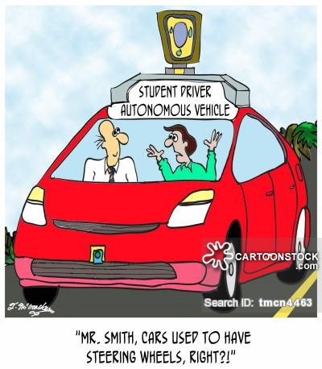
About us
The IBP is a not-for-profit entity, with a dual funding model (public and donor funds, and income from paying users) to support implementation at no cost for the partners we subsidize in Africa.
We offer growing organizations their first car, driving lessons, and some insurance coverage to palliate their first crashes

Slide 4
A dual funding model
Public and donor funds
Income from sales
(cover operational costs )
( mostly cost recovery;
any surplus is reinvested )
One money pot
Product development & maintenance
Capacity development
Consulting services
Deployment
Online help resources
Technical support
Subsidized clients are people from public institutions in developing countries. They receive the BMS PRO products and support services free of charge.
Non-subsidized users can access the BMS PRO products and related services as paying clients. Prices and conditions are scaled in relation to activity sector, project size and world region.

Slide 5
A dual funding model
Income derived from sales is reinvested in:
providing the appropriate service level at client sites for successful implementation
ongoing product development and maintenance
deployment and support at breeding institutions in developing countries
Our paying users are an essential part of the equation:
they take part in the larger mission of closing the gap to improve breeding capacity around the world
they usually spearhead the adoption of better technologies and practices, pulling up other sectors in their wake
they help us ensure sustainability for our products and activities
Sales complement public funding to:
ensure the products can be improved and sustained over time
give access to the same level of technology and services to all our users across the world
contribute to the education of the next generation of breeders
fully join in the global effort towards food security

Slide 6
Partnerships at the heart of our success
A bigger reach with IBP Regional Hubs
Ensuring more reliability with our private partners
Leafnode: software development; code maintenance; data management
VSNi: sales team; promotion, awareness campaigns
DataLive: a consortium for product and market development in Asia
Linking to other plant breeding systems and initiatives (BrAPI GOBII, CassavaBase, etc.)
Networking with service partners
Genotyping laboratories
Phenotyping
Location analysis and climate maps
Breeding informatics
Bringing breeders together through Communities of Practice

Slide 7
Enabling breeders
Access to IBP products, primarily in Sub-Saharan Africa and South and South-East Asia, will enable breeders to modernize their breeding programs:
more effective and efficient selection, saving them time and money;
improved data management by moving into the digital era;
the adoption of best practices and quality certifications;
access to service providers (e.g. genotyping laboratories), reducing the need for in-house investment.

Slide 8
Enabling breeders (cont’d)
… to play an impactful role in Research for Development (R4D):
showcasing local competence to secure international funds;
defining market-driven breeding priorities as central decision makers;
accessing international networks and sources of expertise;
providing their own expertise and support in disseminating knowledge to partners.

Slide 9
We cannot wait 10 to 15 years to deliver varieties anymore! Both disciplines of breeding and bio-technology need to go hand in hand if we want a faster generation of high-powered material. The IBP allows us to federate all our efforts nationally and across the West African sub-region, and thus shorten delays, have more efficient breeding processes and avoid losing money researching things that already exist. We want to see new varieties come out of our laboratories in shorter times, so that African producers may multiply their outputs, and work toward productivities that will let us feed Africa.”
Dr Alioune Fall, General Director,
Senegalese Institute of Agricultural Research (ISRA)

Slide 10
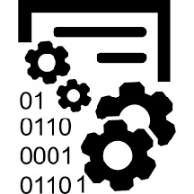
Key drivers:
Data Management
Better data quality and cost reduction at the source, thanks to better performing tools and processes, will boost breeding programs’ efficiency in their capacity to deliver more crop varieties to farmers locally.
80% of a scientist's effort is spent discovering, acquiring, documenting, transforming, and integrating data, whereas only 20% of the effort is devoted to more intellectually stimulating pursuits such as analysis, visualization, and making new discoveries.
The business cost of poor quality data may be as high as 15-25% of an organization's revenue, and as much as 50% of the typical IT budget may be spent in "information scrap and rework".

Slide 11
Key drivers:
Networks and local services
Developing technology is the easy part… we have to find efficient and scalable ways to make sure that would-be users are supported in taking it up. Engaging employees by focusing on their mind-sets and behavior is the primary success factor for growth and widespread adoption of new platforms.
An astounding 66% of information system projects fail, are cancelled or a challenged due to failure of most IS/IT interventions to effectively integrate employee adoption issues.
When leaders ensure that frontline staff members feel a sense of ownership, the results show a 70% success rate for transformations. Furthermore, 60% of the extremely successful change initiatives focus mostly on changing mind-sets.

Slide 12
Key drivers:
Molecular breeding
Phenotypic selection can be greatly enhanced by the use of markers, especially for complex traits easily affected by the environment. Their integration maximizes net value, making for an increasingly attractive economic proposition.
MABC is estimated to have saved at least 2-3 years in the development of the submergence gene for rice in Asia, resulting in significant incremental benefits in the range of USD 300 to 800 million.
In Nigeria, Ghana and Uganda, marker-assisted breeding is estimated to have saved at least 4 years in the breeding cycle for cassava varieties resistant to pests, which will result in incremental net benefits over 25 years in the range of USD 34 to 800 million

Slide 13
Products & Services

Slide 14
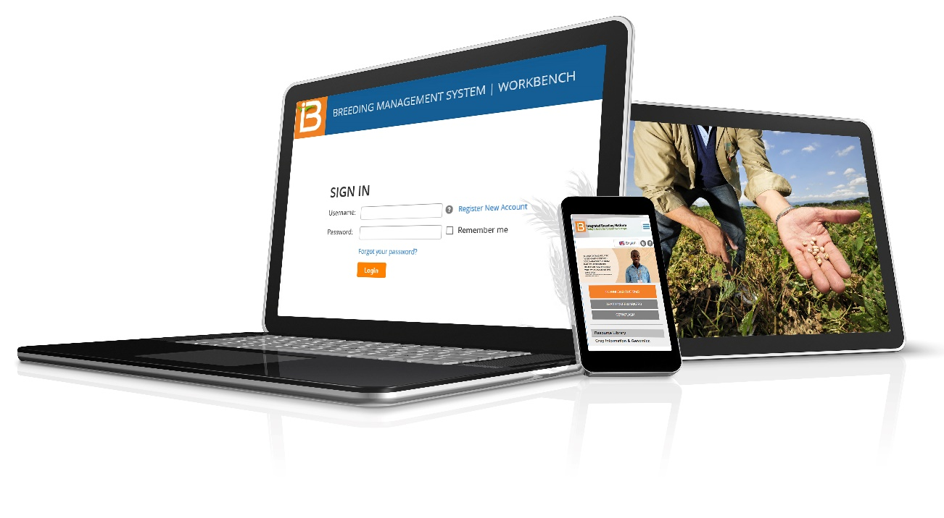
Our core offer
www.integratedbreeding.net
SOFTWARE: a suite of integrated applications – the Breeding Management System (BMS) – partner plugins, and a directory of third-party solutions
SUPPORT: breeding and technical support, social networks and community spaces
SERVICES: a network of service providers for genotyping, phenotyping, location analysis, climate maps and more
PRODUCTS: breeding materials and related information for a broad range of crops, including germplasm, trait dictionaries and predictive markers
KNOWLEDGE: training courses & workshops e-modules, technical documentation and tutorials, and online resources
Credit (photo in tablet: N.Palmer/CIAT

Slide 15
Breeding Management System (BMS)
A suite of interconnected software applications specifically designed to help breeders manage their day-to-day activities:
Programme management
Customise preferences and monitor programme activities from the Workbench, a dashboard application with integrated tools to manage and query crop information across the system
Breeding activities
Prepare trials and nurseries, manage seed inventories and keep continuous genealogy records season after season
Marker-assisted breeding
Select germplasm and design crosses by complementing phenotypic selection with marker technology, for integrated breeding decisions
Statistical analysis
Analyse field and lab data with powerful statistics and mixed model comparisons of locations and genotypes

Slide 16
It used to take me up to three months before I could analyse the data I had collected in the field. Thanks to electronic data capture, I can now proceed with my analysis on the same day .
— Cyril Diatta, sorghum breeder and research assistant, ISRA, Senegal

Slide 17
BMS as a support tool for education
Specific BMS training version
Installation on a local or web server
Concomitant use by multiple users
Backup and restore
Training data sets
Implementation of academic learning
Tutorials and practical exercises available
Test and compare different breeding approaches
Simulate breeding programme activities
BMS course can be part of the student accreditation
Added value to students an Universities:
Exposure to modern and comprehensive analytical pipeline
Facilitate integration into private companies
Same installation can include a production version for student practical work and/or teacher breeding activities.

Slide 18
Training will prove very useful for young breeders to help them go digital in starting up their breeding programs. IBP tools makes the breeding process a shorter one. It helps us become all-round breeders and more efficient in bringing products to end-users, i.e. families and farmers.
— Lilian Njeri Gichuru, maize breeder, Kenya Agricultural Research Institute

Slide 19
Professional services
Installation & technical support
BMS installation and configuration
Quality assurance (testing)
Data migration
Ontology setup and updates
Training on the BMS usage (users, system administrators, data managers)
Support & maintenance package
Specialized:
Functional requests: evaluated on a case-by-case basis and in function of our development cycles.
Professional courses: includes courses on breeding, molecular breeding, data management, advanced statistical techniques; phenotyping and experimental station management.
Consultancy & mentorship: for added expertise on agronomy, phenotyping, molecular breeding or breeding methods.
Associated peripherals: hand-held devices, bar code readers, weighing scales, printers and other associated equipment for modernized plant breeding programs.

Slide 20
Genotyping
A fruitful partnership with LGC
Over 33 million data points generated for our partners
Preferential rates for IBP members
2 dedicated LGC project managers to manage IBP work orders.
Expedited timelines can be arranged for individual projects
All accessible through the IBP website:
Estimating a project with the Cost Calculator
Getting a quotation and/or submit a work order
Requesting a plant collection kit – free of charge with the purchase of LGC services.
Accessing 1000-2000 KASP™ validated SNP markers for 11 key crops

Slide 21
Breeding products
Compilation of products derived from tangible outputs of research: germplasm, markers, genomics resources and informatics
Crop information & genomics
​research results directly applicable to plant breeding, and high-quality germplasm and evaluation data
Trait-linked markers & germplasm resources
Public & validated for traits such as drought, pest, disease, etc. for over 10 crops, and directly available to use in your breeding program

Slide 22
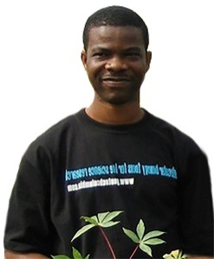
What we’re seeing is a paradigm shift. Now, the developing-country programmes have the boldness and capacity to do molecular breeding and accurate phenotyping for themselves. We built an image for ourselves in Nigeria and in Africa (…) and other global actors, on seeing our ability to deliver results, are now choosing to invest in us.” — Chiedozie Egesi, molecular plant breeder, National Root Crops Research Institute (NRCRI), Nigeria

Slide 23
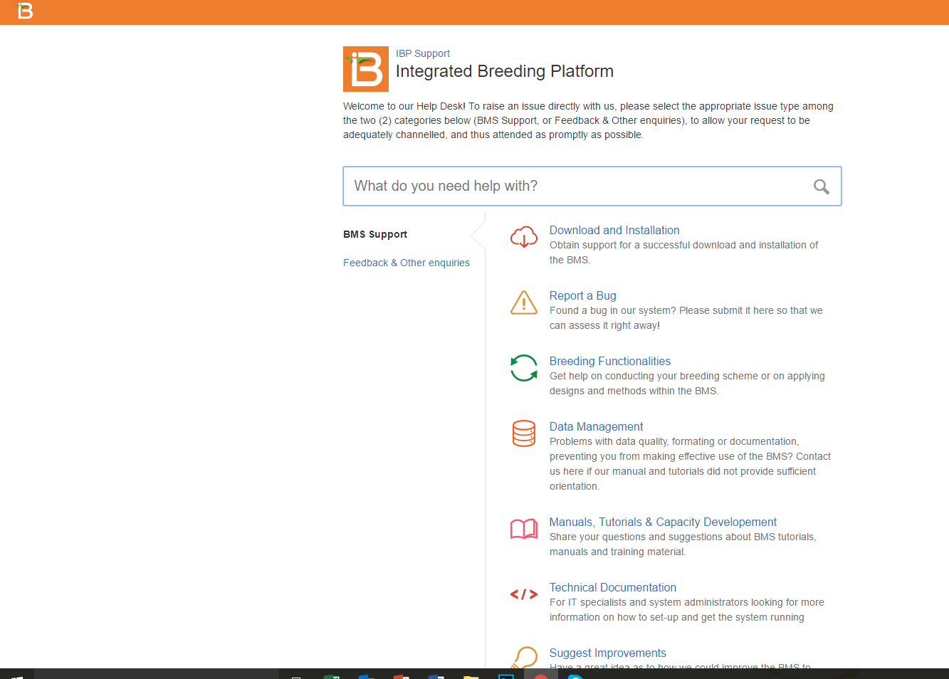
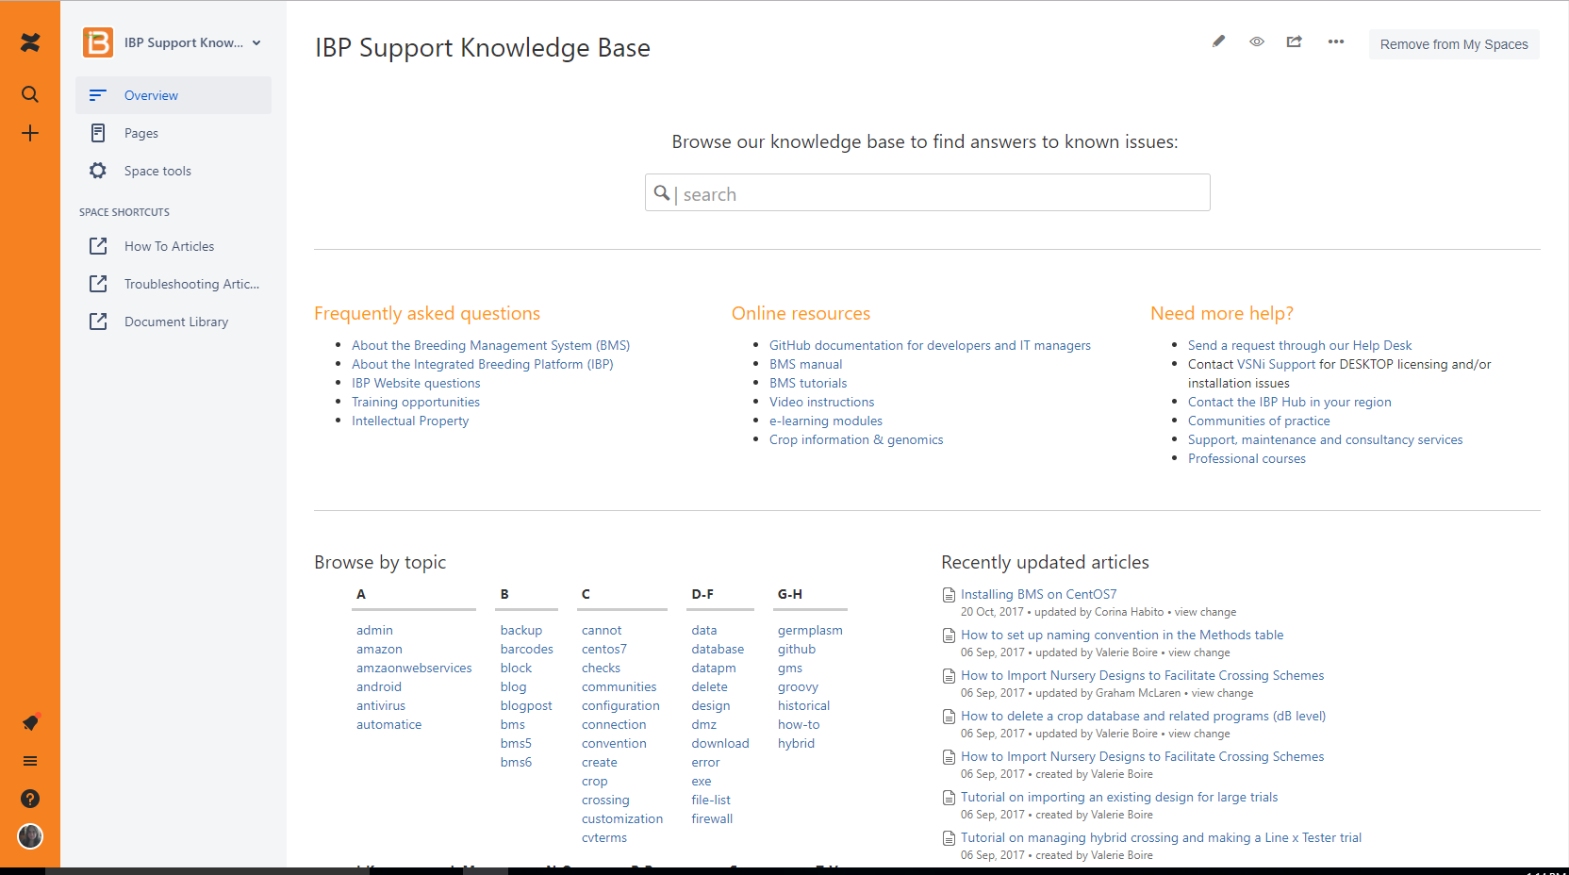
Online resources
Helpdesk

Slide 24
Online resources Documentation & tutorials

Slide 25
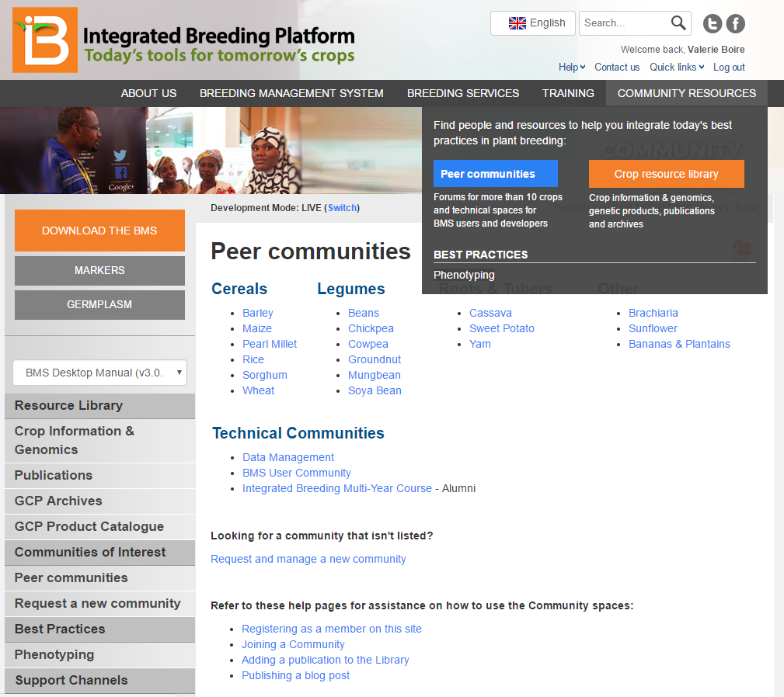
Online resources Peer communities

Slide 26
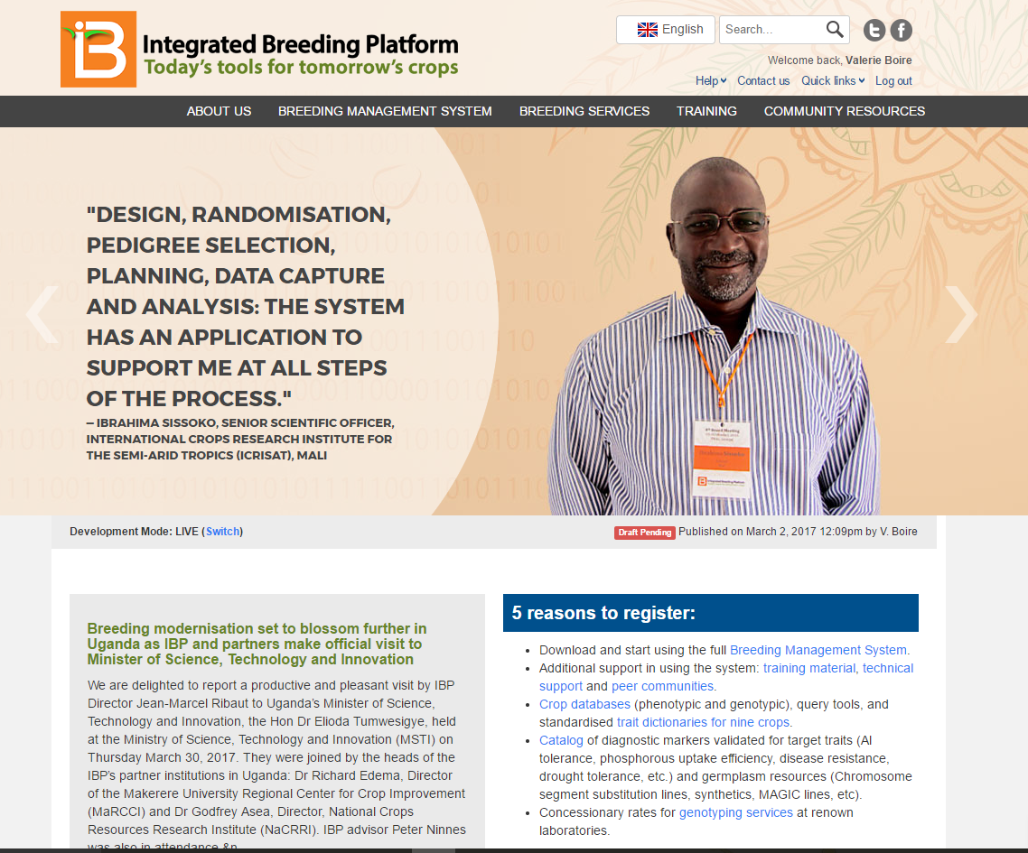
Online resources: More on the IBP Website
www.integratedbreeding.net

Slide 27
Local support teams: providing assistance where you need it
Local staff
IBP Hubs
IBP HQ
IBP future Hubs

Slide 28
Value proposition

Slide 29
Clear benefits
A comprehensive suite
Improved data management
Flexible LAN or cloud solution for a decentralized organizations
Manages breeding information as well as workflow
Support multiple crops within one system
Statistical tools for data analysis and quantitative genetics
Applications for a gradual transition into integrating genotypic data
Data visualization tools, and advanced analytics and decision support tools for better breeding outcomes
Easily integrates with external technologies
More security and preservation / legacy
Standardized documentation and quality control
Easier and faster retrieval and sharing
All in one place, from the field to the lab, thanks to electronic data capture capabilities
Dedicated support
Adapted, from small workgroups to big scale breeding programs
Affordable professional support and training for change management and to ensure success in implementing new technology
Collaboration with international institutions, professionals and academics in extended communities and networks
Dedicated relationship: we know your business and understand your local needs
Meeting educational and research objectives
Online educational resources to help integrate breeding theory with cutting-edge breeding technologies
Customizable educational materials to integrate into a plant breeding curriculum
IBP staff to assist with structuring workshops and curricula
Tangible impact
Crop research data management
Breeding programme efficiency
Crop improvement practices and outputs
Ultimately, on regional economies and food security

Slide 30
Tangible impact at all levels
Breeders:
Increase data quality, documentation and exchange
Savings in time and cost to run breeding activities and to bring new crop varieties
Increased genetic gain at each crop cycle
Enhanced certainty in crop breeding outcomes
Students: learning now how to use breeding software now is added value for prospective employers
Institutions:
Improved institutional data management
Better product at a lower price (efficiency and effectiveness)
Improve the value proposition to attract funding (public) / further Corporate Social Responsibility (CSR) objectives (private)
Society:
Improved crops (quality and yield) in farmers’ fields
More income for smallholder farmers, contributing to a larger-scale impact on regional economy
More and better food to feed the world

Slide 31
Share our vision:
Help us ignite a crop breeding revolution in developing countries, where people drive change through solid and vibrant breeding communities. We want to provide concrete solutions for a new, sustainable operational model in R4D, that will have a huge impact on crop research data management, breeding programme efficiency, crop improvement practices and outputs and, ultimately, on regional economies and food security.

Slide 32
Next steps:
Register on our website: www.integratedbreeding.net
Get a free trial or demo of BMS Pro
Access tutorials, videos, publications and more
Join a Peer Community
Get special rates on breeding services through our network of providers
Request a personalized demo of the BMS: deployment@integratedbreeding.net
Our team will be happy to answer your questions!

